Slide 1


SMART INDIA HACKATHON 2026
TITLE PAGE
Problem Statement ID – SIH26105
Problem Statement Title- AI-Powered Continuous Cyber Risk Quantification and Investment Optimization Platform
Theme- Blockchain & Cybersecurity
PS Category- Software
Team ID- [YOUR TEAM ID]
Team Name (Registered on portal) [YOUR TEAM NAME]

Slide 2
CyberQuant AI
Your Team Name
PROPOSED SOLUTION
CONTINUOUS RISK INTELLIGENCE
• Continuously ingests and normalizes data from vulnerability scanners, SIEM, IAM, EDR and CSPM tools, threat-intelligence feeds and enterprise asset inventories.
• Correlates technical telemetry with business asset criticality to build a single, always-current view of enterprise cyber exposure.
• Automatically refreshes as new vulnerabilities, threats or business changes emerge, replacing stale, manually compiled risk registers.
FINANCIAL RISK QUANTIFICATION
• Translates technical findings such as vulnerabilities, misconfigurations and control gaps into monetary metrics business leaders can act on.
• Computes Expected Annual Loss (EAL) and Value at Risk (VaR) at the organization, business-unit and individual-asset level.
• Models probable loss ranges by combining incident likelihood with downtime, breach, regulatory and reputational cost estimates.
AI DECISION SUPPORT
• Uses predictive analytics to pinpoint the vulnerabilities, threats and control weaknesses driving the largest share of financial risk.
• Recommends prioritized, quantified mitigation actions such as patch deployment, access-control tightening, segmentation and monitoring
• Offers a natural-language query interface so non-technical stakeholders can ask 'What is our highest financial cyber risk today?'.
BUDGET OPTIMIZATION
• Runs optimization models that select the combination of controls and remediations delivering maximum risk reduction under a fixed budget.
• Computes ROSI (Return on Security Investment) and cost-benefit metrics to support board-level approval of security spend.
• Visualizes Investment-vs-Risk-Reduction curves to reveal diminishing returns and highlight the optimal spend zone.
TECHNICAL RISK → FINANCIAL EXPOSURE → OPTIMIZED SECURITY INVESTMENT

Slide 3
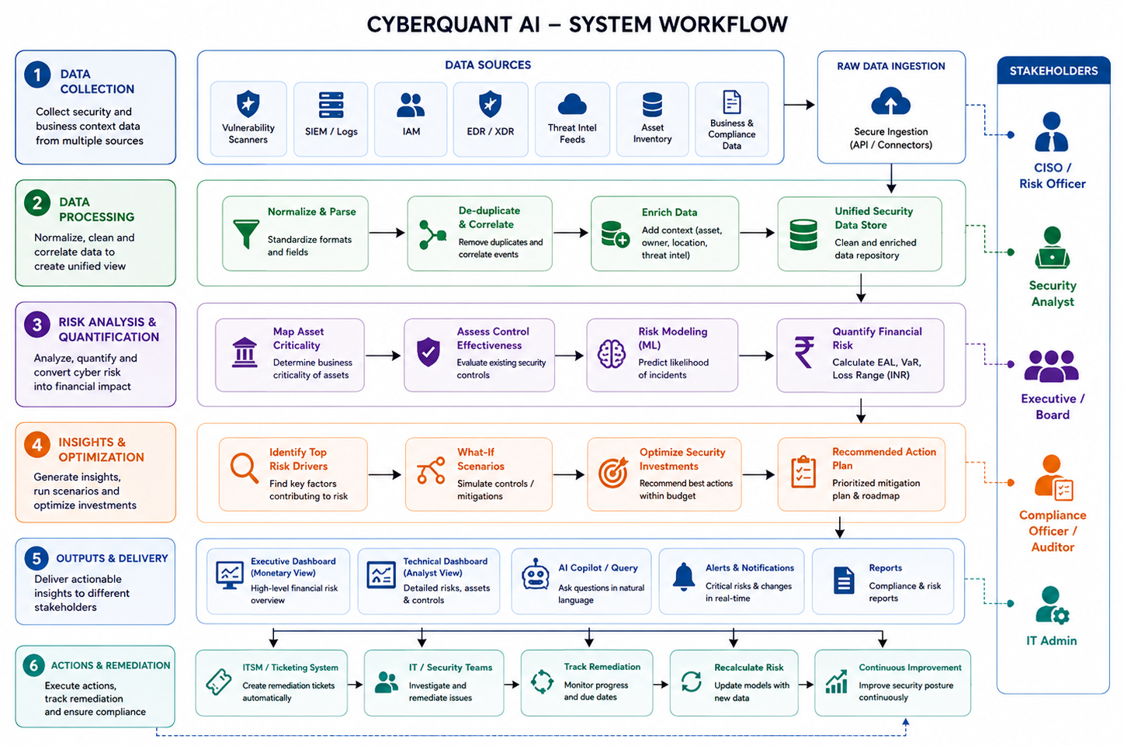
TECHNICAL APPROACH
Your Team Name
TECHNOLOGY STACK
Frontend: Next.js / React, TypeScript, Tailwind CSS
Backend: Python, FastAPI, PostgreSQL, Redis
AI / ML: XGBoost, scikit-learn, SHAP, Grounded LLM interface
Risk Analytics: NumPy, SciPy, Monte Carlo Simulation
Optimization: Google OR-Tools
Deployment: Docker, cloud-ready architecture
Data Sources: NVD/CVE, CISA KEV, SIEM, IAM, EDR, CSPM, Asset Inventory

Slide 4
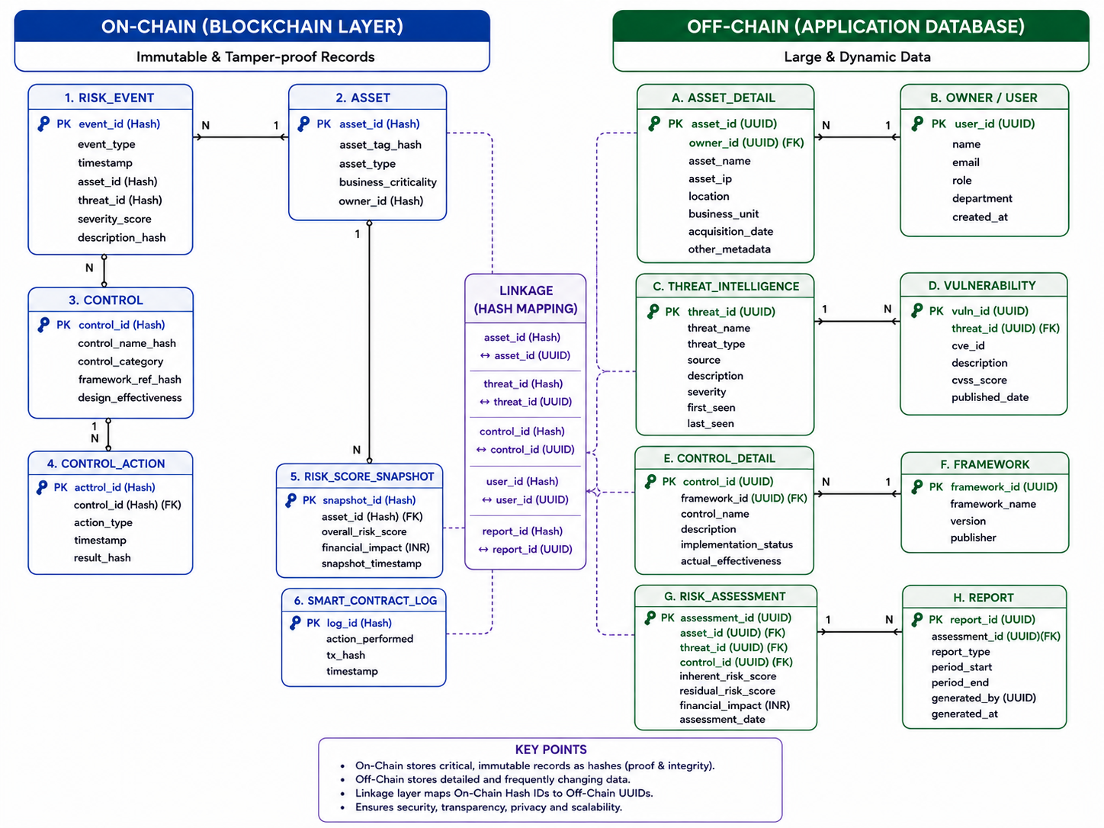
FEASIBILITY AND VIABILITY
Your Team Name
FEASIBILITY
• Technical feasibility is high: the platform is built on mature, production-ready ML, probabilistic risk modelling, optimization solvers and cloud-native APIs.
• Modular architecture lets connectors, the analytics engine, optimization module and dashboards be built, scaled and upgraded independently.
• Designed for easy adoption: it complements and integrates with existing enterprise security tools rather than replacing them.
HYBRID DATA ARCHITECTURE — ON-CHAIN ↔ OFF-CHAIN
KEY CHALLENGES
• Telemetry from SIEM, EDR, IAM and CSPM tools is often incomplete, inconsistent or noisy, complicating reliable correlation and scoring.
• Sparse historical incident and loss data constrains the statistical confidence of financial-impact estimates.
• Sensitive enterprise data plus fast-evolving threats and controls create ongoing risk of model drift over time.
MITIGATION
• Rigorous data normalization and automated quality scoring are applied to every telemetry source before it feeds the risk engine
• Calibrated statistical/ML models output confidence ranges rather than false-precision point estimates, validated by human experts
• Strict RBAC and encryption protect sensitive data, with continuous monitoring to detect and correct model drift as threats evolve.

Slide 5
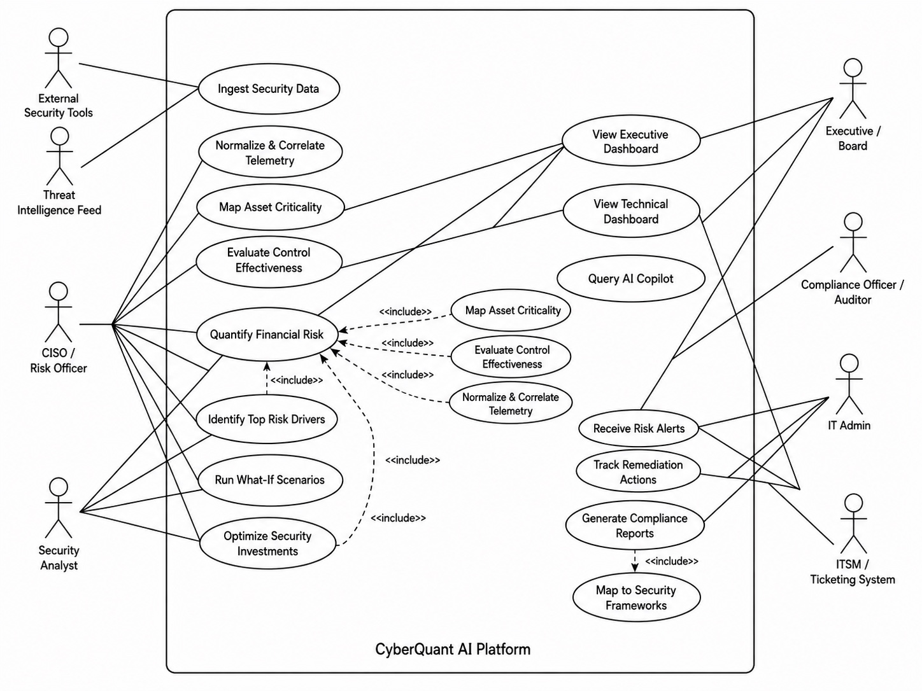
IMPACT AND BENEFITS
Your Team Name
TARGET USERS
USE CASE DIAGRAM
CISOs / Risk Officers
• Gain continuous, monetary visibility into enterprise cyber risk and a prioritized, quantified list of mitigation actions to act on.
Executives / Boards
• Understand cybersecurity posture and investment decisions expressed in financial and business terms rather than technical jargon.
Security Teams
• Prioritize remediation work based on business impact, exploitability and current control effectiveness, not just severity scores.
Auditors / Regulators
• Access evidence-based, framework-mapped compliance and governance reporting suitable for audits and regulatory filings.
BENEFITS
ECONOMIC
• Improves security-budget allocation by directing spend to the highest financial-risk-reduction opportunities.
• Cuts under- and over-spending by replacing guesswork with quantified, evidence-based investment planning.
OPERATIONAL
• Delivers near-real-time visibility into enterprise cyber exposure instead of stale, periodic assessments.
• Speeds up remediation prioritization and supports rapid what-if decision-making during incidents.
GOVERNANCE
• Produces explainable, defensible risk decisions that hold up to audit and board scrutiny.
• Strengthens executive communication and regulatory readiness across frameworks like NIST and ISO.

Slide 6
RESEARCH AND REFERENCES
Your Team Name
OFFICIAL REFERENCES
COMPARISON WITH TRADITIONAL APPROACH
• NIST Cybersecurity Framework 2.0
Provides the govern-identify-protect-detect-respond-recover structure used for framework mapping.
• NIST National Vulnerability Database
Authoritative CVE source feeding the platform's vulnerability and risk-scoring engine
• CISA Known Exploited Vulnerabilities Catalog
Prioritizes remediation of vulnerabilities with confirmed real-world exploitation
• ISO/IEC 27001:2022
International standard for information security management referenced in compliance reporting
• CIS Critical Security Controls
Prioritized safeguards used to benchmark control effectiveness and coverage
• RBI Cyber Security Framework
Regulatory baseline for financial-sector cyber risk governance in India
• SEBI Cybersecurity and Cyber Resilience Framework
Securities-market regulatory framework supporting audit-ready governance reporting
Feature | Traditional | CyberQuant AI
Risk Representation | Low / Medium / High | Monetary Exposure
Assessment | Periodic | Continuous
Prioritization | Severity-Based | Financial-Impact Based
Investment Planning | Manual | Budget-Optimized
Scenario Analysis | Limited | What-If Simulation
Executive Interpretation | Technical | Business / Financial

